Slide 2
Objectives
Describe an overview of Transact-SQL programming
Describe the Transact-SQL programming elements
Describe program flow statements
Describe various Transact-SQL functions
Explain the procedure to create and alter user-defined functions (UDFs)
Explain creation of windows with OVER
Describe window functions

Slide 3
Introduction
Transact-SQL programming is:
a procedural language extension to SQL.
extended by adding the subroutines and programming structures similar to high-level languages.
Transact-SQL programming also has rules and syntax that control and enable programming statements to work together.
Users can control the flow of programs by using conditional statements such as IF and loops such as WHILE.

Slide 4
Transact-SQL Programming Elements 1-2
Transact-SQL programming elements enable to perform various operations that cannot be done in a single statement.
Users can group several Transact-SQL statements together by using one of the following ways:
Batches
Stored Procedures
Triggers
Scripts
Is a collection of one or more Transact-SQL statements that are sent as one unit from an application to the server.
Is a collection of Transact-SQL statements that are precompiled and predefined on the server.
Is a special type of stored procedure that is executed when the user performs an event such as an INSERT, DELETE, or UPDATE operation on a table.
Is a chain of Transact-SQL statements stored in a file that is used as input to the SSMS code editor or sqlcmd utility.

Slide 5
Transact-SQL Programming Elements 2-2
The following features enable users to work with Transact-SQL statements:
Variables
Control-of-flow
Error Handling
Allows a user to store data that can be used as input in a Transact-SQL statement.
Is used for including conditional constructs in Transact-SQL.
Is a mechanism that is used for handling errors and provides information to the users about the error occurred.

Slide 6
Transact-SQL Batches 1-5
Is a group of one or more Transact-SQL statements sent to the server as one unit from an application for execution.
SQL Server compiles the batch SQL statements into a single executable unit, also called as an execution plan.
In the execution plan, the SQL statements are executed one by one.
A Transact-SQL batch statement should be terminated with a semicolon.
A compile error such as syntax error restricts the compilation of the execution plan.

Slide 7
Transact-SQL Batches 2-5
A run-time error such as a constraint violation or an arithmetic overflow has one of the following effects:
Most of the run-time errors stop the current statement and the statements that follow in the batch.
A specific run-time error such as a constraint violation stops only the existing statement and the remaining statements in the batch are executed.
SQL statements that execute before the run-time error is encountered are unaffected.

Slide 8
Transact-SQL Batches 3-5
Following rules are applied to use batches:
CREATE FUNCTION, CREATE DEFAULT, CREATE RULE, CREATE TRIGGER, CREATE PROCEDURE, CREATE VIEW, and CREATE SCHEMA statements cannot be jointly used with other statements in a batch.
CREATE SQL statement starts the batch and all other statements that are inside the batch will be considered as a part of the CREATE statement definition.
No changes are made in the table and the new columns reference the same batch.
If the first statement in a batch has the EXECUTE statement, then, the EXECUTE keyword is not required.

Slide 9
Transact-SQL Batches 4-5
Following code snippet shows how to create a batch:
BEGIN TRANSACTION
GO
USE AdventureWorks2012;
GO
CREATE TABLE Company
(
Id_Num int IDENTITY(100, 5),
Company_Name nvarchar(100)
)
GO
INSERT Company (Company_Name)
VALUES (N'A Bike Store')
INSERT Company (Company_Name)
VALUES (N'Progressive Sports')
INSERT Company (Company_Name)
VALUES (N'Modular Cycle Systems')
INSERT Company (Company_Name)
VALUES (N'Advanced Bike Components')

Slide 10
Transact-SQL Batches 5-5
INSERT Company (Company_Name)
VALUES (N'Metropolitan Sports Supply')
INSERT Company (Company_Name)
VALUES (N'Aerobic Exercise Company')
INSERT Company (Company_Name)
VALUES (N'Associated Bikes')
INSERT Company (Company_Name)
VALUES (N'Exemplary Cycles')
GO
SELECT Id_Num, Company_Name
FROM dbo. Company
ORDER BY Company_Name ASC;
GO
COMMIT;
GO

Slide 11
Transact-SQL Variables 1-8
Variables allow users to store data for using as input in a Transact-SQL statement.
Users can use variables in the WHERE clause, and write the logic to store the variables with the appropriate data.
SQL Server provides the DECLARE, SET, and SELECT statements to set and declare local variables.

Slide 12
Transact-SQL Variables 2-8
DECLARE: Variables are assigned values by using the SELECT or SET statement and are initialized with NULL values if the user has not provided a value at the time of the declaration.
Syntax:
DECLARE {{ @local_variable [AS] data_type } | [ = value ] }
where,
@local_variable: specifies the name of the variables and begins with @ sign.
data_type: specifies the data type. A variable cannot be of image, text, or ntext data type.
=value: Assigns an inline value to a variable. The value can be an expression or a constant value. The value should match with the variable declaration type or it should be implicitly converted to that type.

Slide 13
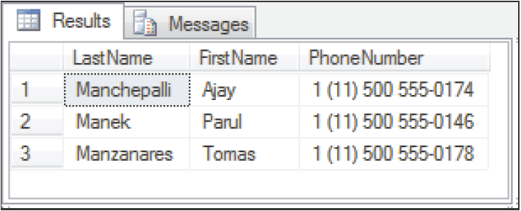
Transact-SQL Variables 3-8
Following code snippet shows the use of a local variable to retrieve contact information for the last names starting with Man:
USE AdventureWorks2012;
GO
DECLARE @find varchar(30) = 'Man%';
SELECT p.LastName, p.FirstName, ph.PhoneNumber
FROM Person.Person AS p
JOIN Person.PersonPhone AS ph ON p.BusinessEntityID = ph.BusinessEntityID
WHERE LastName LIKE @find;
Output:

Slide 14
Transact-SQL Variables 4-8
SET: statement sets the local variable created by the DECLARE statement to the specified value.
Syntax:
SET
{ @local_variable = { expression}
}
|
{ @local_variable
{+= | -= | *= | /= | %= | &= | ^= | |= } expression
}
where,
@local_variable: specifies the name of the variables and begins with @ sign.
=: Assigns the value on the right-hand side to the variable on the left-hand side.
{= | += | -= | *= | /= | %= | &= | ^= | |= }: specifies the compound assignment operators.
expression: specifies any valid expression which can even include a scalar subquery.

Slide 15
Transact-SQL Variables 5-8
Following code snippet demonstrates the use of SET to assign a string value to a variable:
DECLARE @myvar char(20);
SET @myvar = 'This is a test';

Slide 16
Transact-SQL Variables 6-8
SELECT: statement indicates that the specified local variable that was created using DECLARE should be set to the given expression.
Syntax:
SELECT { @local_variable { = | += | -= | *= | /= | %= | &= | ^= | |= } expression } [ ,...n ] [ ; ]
where,
@local_variable: specifies the name of the variables and begins with @ sign.
=: Assigns the value on the right-hand side to the variable on the left-hand side.
{= | += | -= | *= | /= | %= | &= | ^= | |= }: specifies the compound assignment operators.
expression: specifies any valid expression which can even include a scalar subquery.

Slide 17
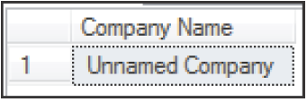
Transact-SQL Variables 7-8
Following code snippet demonstrates the use of SELECT to return a single value:
USE AdventureWorks2012 ;
GO
DECLARE @var1 nvarchar(30);
SELECT @var1 = 'Unnamed Company';
SELECT @var1 = Name
FROM Sales.Store
WHERE BusinessEntityID = 10;
SELECT @var1 AS 'Company Name';
Output:

Slide 18
Transact-SQL Variables 8-8
SET
Assigns only one variable at a time
Assigns a scalar value when assigning from a query. It raises an error and does not work if the query returns multiple values/rows
SELECT
Can make multiple assignments at once
Assigns one of the returned values to the variable and the user will not even know that multiple values were returned
To assign variables, it is recommended to use SET @local_variable instead of SELECT @local_variable

Slide 19
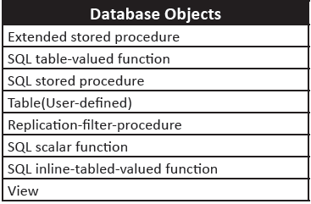
Synonyms 1-6
Are database objects that serve the following purposes:
They offer another name for a different database object, also called as the base object, which may exist on a remote or local server.
They present a layer of abstraction that guards a client application from the modifications made to the location and the name of the base object.
A synonym is a part of schema, and like other schema objects, the synonym name must be unique.
Following table lists the database objects for which the users can create synonyms.

Slide 20
Synonyms 2-6
Synonyms and Schemas
Users want to create a synonym and have a default schema that is not owned by them.
They can qualify the synonym name with the schema name that they actually own.
Granting Permissions on Synonyms
Only members of the roles db_owner or db_ddladmin or synonym owners are allowed to grant permissions on a synonym.
Users can deny, grant, or revoke all or any of the permissions on a synonym.

Slide 21
Synonyms 3-6
Working with Synonyms
Users can work with synonyms in SQL Server 2012 using either Transact-SQL or SSMS.
To create a synonym using SSMS, perform the following steps:
In Object Explorer, expand the database where you want to create a new synonym
Select the Synonyms folder, right-click it, and then, click New Synonym…
In the New Synonym dialog box, provide the following information:
Synonym name: is the new name for the object.
Synonym schema: is the new name for the schema object.
Server name: is the name of the server to be connected.
Database name: is the database name to connect the object.
Schema: is the schema that owns the object.

Slide 22
Synonyms 4-6
To create a synonym using Transact-SQL, perform the following steps:
Connect to the Database Engine.
Click New Query in the Standard bar.
Write the query to create the synonym in the query window.
Click Execute on the toolbar to complete creation of the synonym.

Slide 23
Synonyms 5-6
Syntax:
CREATE SYNONYM [ schema_name_1. ] synonym_name FOR <object>
<object> :: =
{
[ server_name.[ database_name ] . [ schema_name_2 ].| database_name . [ schema_name_2 ].| schema_name_2. ] object_name
}
where,
schema_name_1: states that the schema in which the synonym is created.
synonym_name: specifies the new synonym name.
server_name: specifies the server name where the base object is located.
database_name: specifies the database name where the base object is located.
schema_name_2: specifies the schema name of the base object.
object_name: specifies the base object name, which is referenced by the synonym.

Slide 24
Synonyms 6-6
Following code snippet creates a synonym from an existing table:
USE tempdb;
GO
CREATE SYNONYM MyAddressType
FOR AdventureWorks2012.Person.AddressType;
GO

Slide 25
Program Flow Statements 1-8
Different types of program flow statements and functions supported by Transact-SQL are as follows:
Transact-SQL statements are executed sequentially, in the order they occur.
Transact-SQL Control-of-Flow language
Determines the execution flow of Transact-SQL statements, statement blocks, user-defined functions, and stored procedures.
Allow statements to be executed in a particular order, to be related to each other, and made interdependent using constructs similar to programming languages.

Slide 26
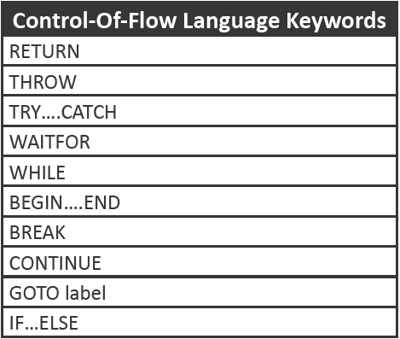
Program Flow Statements 2-8
Following table lists some of the Transact-SQL control-of-flow language keywords:

Slide 27
Program Flow Statements 3-8
BEGIN…END statements surround a series of Transact-SQL statements so that a group of Transact-SQL statements is executed.
Syntax:
BEGIN
{
sql_statement | statement_block
}
END
where,
{sql_statement| statement_block}: Is any valid Transact-SQL statement that is defined using a statement block.

Slide 28
Program Flow Statements 4-8
Following code snippet shows the use of BEGIN and END statements:
USE AdventureWorks2012;
GO
BEGIN TRANSACTION;
GO
IF @@TRANCOUNT = 0
BEGIN
SELECT FirstName, MiddleName
FROM Person.Person WHERE LastName = 'Andy';
ROLLBACK TRANSACTION;
PRINT N'Rolling back the transaction two times would cause an error.';
END;
ROLLBACK TRANSACTION;
PRINT N'Rolled back the transaction.';
GO

Slide 29
Program Flow Statements 5-8
IF…ELSE statement enforces a condition on the execution of a Transact-SQL statement.
Transact-SQL statement is followed with the IF keyword and the condition executes only if the condition is satisfied and returns TRUE.
ELSE keyword is an optional Transact-SQL statement that executes only when the IF condition is not satisfied and returns FALSE.
Syntax:
IF Boolean_expression
{ sql_statement | statement_block }
[ ELSE
{ sql_statement | statement_block } ]
where,
Boolean_expression: specifies the expression that returns TRUE or FALSE value

Slide 30
Program Flow Statements 6-8
{sql_statement | statement_block}: Is any valid Transact-SQL statement that is defined using a statement block.
Following code snippet shows the use of IF…ELSE statements:
USE AdventureWorks2012
GO
DECLARE @ListPrice money;
SET @ListPrice = (SELECT MAX(p.ListPrice)
FROM Production.Product AS p
JOIN Production.ProductSubcategory AS s
ON p.ProductSubcategoryID = s.ProductSubcategoryID
WHERE s.[Name] = 'Mountain Bikes');
PRINT @ListPrice
IF @ListPrice <3000
PRINT 'All the products in this category can be purchased for an amount less than 3000'
ELSE
PRINT 'The prices for some products in this category exceed 3000'

Slide 31
Program Flow Statements 7-8
WHILE - statements specifies a condition for the repetitive execution of the statement block.
Statements are executed repetitively as long as the specified condition is true.
The execution of statements in the WHILE loop can be controlled by using the BREAK and CONTINUE keywords.
Syntax:
WHILE Boolean_expression
{ sql_statement | statement_block | BREAK | CONTINUE }
where,
Boolean_expression: specifies the expression that returns TRUE or FALSE value
{sql_statement| statement_block}: Is any valid Transact-SQL statement that is defined using a statement block.
BREAK: Results in an exit from the innermost WHILE loop.
CONTINUE: Results in the WHILE loop being restarted.

Slide 32
Program Flow Statements 8-8
Following code snippet shows the use of WHILE statements:
DECLARE @flag int
SET @flag = 10
WHILE (@flag <=95)
BEGIN
IF @flag%2 =0
PRINT @flag
SET @flag = @flag + 1
CONTINUE;
END
GO

Slide 33
Transact-SQL Functions 1-5
Transact-SQL functions that are commonly used are as follows:
Deterministic and non-deterministic functions
User-defined functions possess properties that define the capability of the SQL Server Database Engine.
Database engine is used to index the result of a function through either computed columns that the function calls or the indexed views that reference the functions.
Deterministic functions return the same result every time they are called with a definite set of input values and specify the same state of the database.
Non-deterministic functions return different results every time they are called with specified set of input values even though the database that is accessed remains the same.
Every built-in function is deterministic or non-deterministic depending on how the function is implemented by SQL Server.

Slide 34
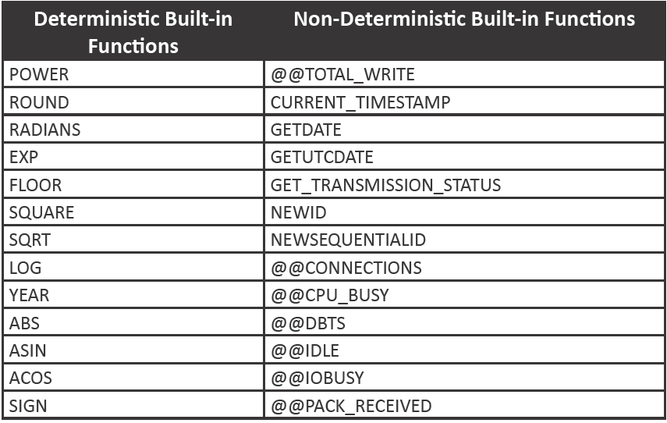
Transact-SQL Functions 2-5
Following table lists some deterministic and non-deterministic built-in functions:

Slide 35
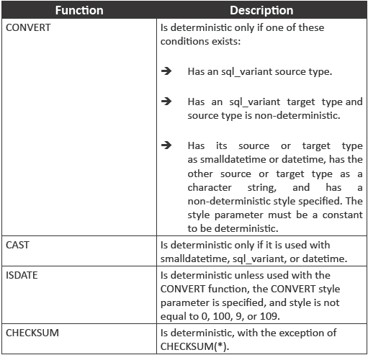
Transact-SQL Functions 3-5
Following table lists some functions that are not always deterministic but you can use them in indexed views if they are given in a deterministic manner:

Slide 36
Transact-SQL Functions 4-5
Calling Extended Stored Procedures from Functions
Functions calling extended stored procedures are non-deterministic because the extended stored procedures may result in side effects on the database.
While executing an extended stored procedure from a user-defined function, the user cannot assure that it will return a consistent resultset.
Therefore, the user-defined functions that create side effects on the database are not recommended.
Scalar-Valued Functions
A Scalar-Valued Function (SVF) always returns an int, bit, or string value.
Data type returned from and the input parameters of SVF can be of any data type except text, ntext, image, cursor, and timestamp.
An inline scalar function has a single statement and no function body.
A multi-statement scalar function encloses the function body in a BEGIN...END block.

Slide 37
Transact-SQL Functions 5-5
Table-Valued Functions
Table-valued functions are user-defined functions that return a table.
Similar to an inline scalar function, an inline table-valued function has a single statement and no function body.
Following code snippet shows the creation of a table-valued function:
USE AdventureWorks2012;
GO
IF OBJECT_ID (N'Sales.ufn_CustDates', N'IF') IS NOT NULL
DROP FUNCTION Sales.ufn_ufn_CustDates;
GO
CREATE FUNCTION Sales.ufn_CustDates ()
RETURNS TABLE
AS
RETURN
(
SELECT A.CustomerID, B.DueDate, B.ShipDate
FROM Sales.Customer A
LEFT OUTER JOIN
Sales.SalesOrderHeader B
ON
A.CustomerID = B.CustomerID AND YEAR(B.DueDate)<2012
);

Slide 38
Altering User-defined Functions 1-3
Limitations and Restrictions
Permissions
ALTER FUNCTION does not allow the users to perform the following actions:
ALTER permission is required on the schema or the function.
Modify a scalar-valued function to a table-valued function.
Modify an inline function to a multi-statement function.
Modify a Transact-SQL to a CLR function.
If the function specifies a user-defined type, then it requires the EXECUTE permission on the type.

Slide 39
Altering User-defined Functions 2-3
Modifying a User-defined function using SSMS
Users can also modify user-defined functions using SSMS
Click the plus (+) symbol beside the database that contains the function to be modified.
Click the plus (+) symbol next to the Programmability folder.
Click the plus (+) symbol next to the folder, which contains the function to be modified.
To modify the user-defined function using SSMS, perform the following steps:
Right-click the function to be modified and then, select Modify. The code for the function appears in a query editor window.
In the query editor window, make the required changes to the ALTER FUNCTION statement body.
Click Execute on the toolbar to execute the ALTER FUNCTION statement.

Slide 40
Altering User-defined Functions 3-3
Modifying a User-defined function using Transact-SQL
To modify the user-defined function using Transact-SQL, perform the following steps:
In the Object Explorer, connect to the Database Engine instance.
On the Standard bar, click New Query.
Type the ALTER FUNCTION code in the Query Editor.
Click Execute on the toolbar to execute the ALTER FUNCTION statement.
Following code snippet demonstrates modifying a table-valued function:
USE [AdventureWorks2012]
GO
ALTER FUNCTION [dbo].[ufnGetAccountingEndDate]()
RETURNS [datetime]
AS
BEGIN
RETURN DATEADD(millisecond, -2, CONVERT(datetime, '20040701', 112));
END;

Slide 41
Creation of Windows with OVER
A window function is a function that applies to a collection of rows.
The word 'window' is used to refer to the collection of rows that the function works on.
OVER clause is used to define a window within a query resultset.

Slide 42
Windowing Components 1-3
The three core components of creating windows with the OVER clause are as follows:
Partitioning - is a feature that limits the window of the recent calculation to only those rows from the resultset that contains the same values in the partition columns as in the existing row.
Following code snippet demonstrates use of the PARTITION BY and OVER clauses with aggregate functions:
USE AdventureWorks2012;
GO
SELECT SalesOrderID, ProductID, OrderQty
,SUM(OrderQty) OVER(PARTITION BY SalesOrderID) AS Total
,MAX(OrderQty) OVER(PARTITION BY SalesOrderID) AS MaxOrderQty
FROM Sales.SalesOrderDetail
WHERE ProductId IN(776, 773);
GO

Slide 43
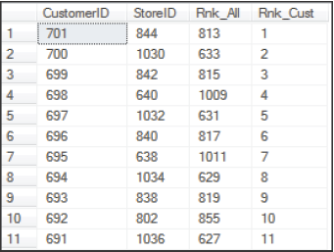
Windowing Components 2-3
Ordering - element defines the ordering for calculation in the partition. In SQL Server 2012, there is a support for the ordering element with aggregate functions.
Following code snippet demonstrates an example of the ordering element:
SELECT CustomerID, StoreID,
RANK() OVER(ORDER BY StoreID DESC) AS Rnk_All,
RANK() OVER(PARTITION BY PersonID
ORDER BY CustomerID DESC) AS Rnk_Cust
FROM Sales.Customer;
Output:

Slide 44
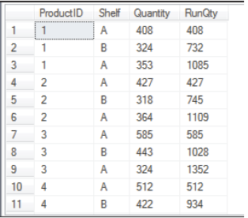
Windowing Components 3-3
Framing - is a feature that enables you to specify a further division of rows within a window partition. a frame is like a moving window over the data that starts and ends at specified positions and is defined using the ROW or RANGE subclauses.
Following code snippet displays a query against the ProductInventory, calculating the running total quantity for each product and location:
SELECT ProductID, Shelf, Quantity,
SUM(Quantity) OVER(PARTITION BY ProductID
ORDER BY LocationID
ROWS BETWEEN UNBOUNDED PRECEDING
AND CURRENT ROW) AS RunQty
FROM Production.ProductInventory;
Output:

Slide 45
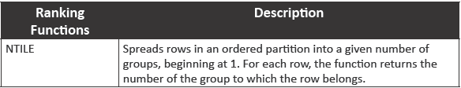
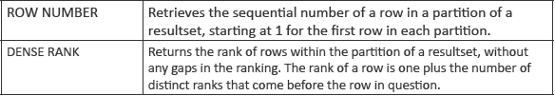
Window Functions 1-9
Some of the different types of window functions are as follows:
Ranking functions - return a rank value for each row in a partition. Based on the function that is used, many rows will return the same value as the other rows and are non-deterministic.
Following table lists the various ranking functions:

Slide 46
Window Functions 2-9
Following code snippet demonstrates the use of ranking functions:
USE AdventureWorks2012;
GO
SELECT p.FirstName, p.LastName
,ROW_NUMBER() OVER (ORDER BY a.PostalCode) AS 'Row Number'
,NTILE(4) OVER (ORDER BY a.PostalCode) AS 'NTILE'
,s.SalesYTD, a.PostalCode
FROM Sales.SalesPerson AS s
INNER JOIN Person.Person AS p
ON s.BusinessEntityID = p.BusinessEntityID
INNER JOIN Person.Address AS a
ON a.AddressID = p.BusinessEntityID
WHERE TerritoryID IS NOT NULL
AND SalesYTD <> 0;

Slide 47
Window Functions 3-9
OFFSET functions - Different types of offset functions are as follows:
SWITCHOFFSET - returns a DATETIMEOFFSET value that is modified from the stored time zone offset to a specific new time zone offset.
Syntax:
SWITCHOFFSET ( DATETIMEOFFSET, time_zone )
where,
DATETIMEOFFSET: is an expression that is resolved to a datetimeoffset(n) value.
time_zone: specifies the character string in the format [+|-]TZH:TZM or a signed integer (of minutes) which represents the time zone offset, and is assumed to be daylight-saving aware and adjusted.

Slide 48
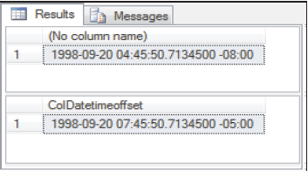
Window Functions 4-9
Following code snippet demonstrates the use of SWITCHOFFSET function:
CREATE TABLE Test
(
ColDatetimeoffset datetimeoffset
);
GO
INSERT INTO Test
VALUES ('1998-09-20 7:45:50.71345 -5:00');
GO
SELECT SWITCHOFFSET (ColDatetimeoffset, '-08:00')
FROM Test;
GO
--Returns: 1998-09-20 04:45:50.7134500 -08:00
SELECT ColDatetimeoffset
FROM Test;
Output:

Slide 49
Window Functions 5-9
DATETIMEOFFSETFROMPARTS – returns a datetimeoffset value for the specified date and time with specified precision and offset.
Syntax:
DATETIMEOFFSETFROMPARTS ( year, month, day, hour,
minute, seconds, fractions, hour_offset,
minute_offset, precision )
where,
year: specifies the integer expression for a year.
month: specifies the integer expression for a month.
day: specifies the integer expression for a day.
hour: specifies the integer expression for an hour.
minute: specifies the integer expression for a minute.
seconds: specifies the integer expression for a day.
fractions: specifies the integer expression for fractions.
hour_offset: specifies the integer expression for the hour portion of the time zone offset.
minute_offset: specifies the integer expression for the minute portion of the time zone offset.
precision: specifies the integer literal precision of the datetimeoffset value to be returned.

Slide 50
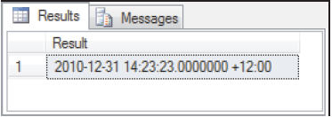
Window Functions 6-9
Following code snippet demonstrates the use of DATETIMEOFFSETFROMPARTS function:
SELECT DATETIMEOFFSETFROMPARTS ( 2010, 12, 31, 14, 23, 23, 0, 12, 0,
7 )
AS Result;
Output:

Slide 51
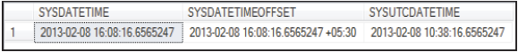
Window Functions 7-9
SYSDATETIMEOFFSET – returns datetimeoffset(7) value which contains the date and time of the computer on which the instance of SQL Server is running.
Syntax:
SYSDATETIMEOFFSET ()
Following code snippet demonstrates the use of different formats used by the date and time functions:
SELECT SYSDATETIME() AS SYSDATETIME
,SYSDATETIMEOFFSET() AS SYSDATETIMEOFFSET
,SYSUTCDATETIME() AS SYSUTCDATETIME
Output:

Slide 52
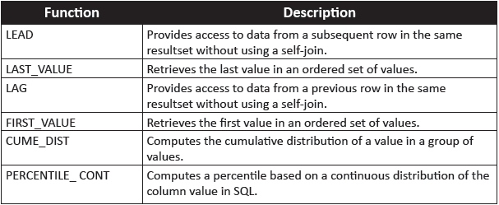
Window Functions 8-9
Analytic functions - compute aggregate value based on a group of rows. Analytic functions compute running totals, moving averages, or top-N results within a group.
Following table lists the various analytic functions:

Slide 53
Window Functions 9-9
Following code snippet demonstrates the use of LEAD() function:
USE AdventureWorks2012;
GO
SELECT BusinessEntityID, YEAR(QuotaDate) AS QuotaYear, SalesQuota AS NewQuota,
LEAD(SalesQuota, 1,0) OVER (ORDER BY YEAR(QuotaDate)) AS FutureQuota
FROM Sales.SalesPersonQuotaHistory
WHERE BusinessEntityID = 275 and YEAR(QuotaDate) IN ('2007','2008');
Following code snippet demonstrates the use of FIRST_VALUE() function:
USE AdventureWorks2012;
GO
SELECT Name, ListPrice,
FIRST_VALUE(Name) OVER (ORDER BY ListPrice ASC) AS LessExpensive
FROM Production.Product
WHERE ProductSubcategoryID = 37

Slide 54
Summary
Transact-SQL provides basic programming elements like variables, control-of-flow elements, conditional, and loop constructs.
A batch is a collection of one or more Transact-SQL statements that are sent as one unit from an application to the server.
Variables allow users to store data for using as input in other Transact-SQL statements.
Synonyms provide a way to have an alias for a database object that may exist on a remote or local server.
Deterministic functions each time return the same result every time they are called with a definite set of input values and specify the same state of the database.
Non-deterministic functions return different results every time they are called with specified set of input values even though the database that is accessed remains the same.
A window function is a function that applies to a collection of rows.

